Slide 1
I am thankful...
By: Miss Waldrop

Slide 2

My class
I am thankful for my class because they make me smile and they make me so proud everyday!

Slide 3
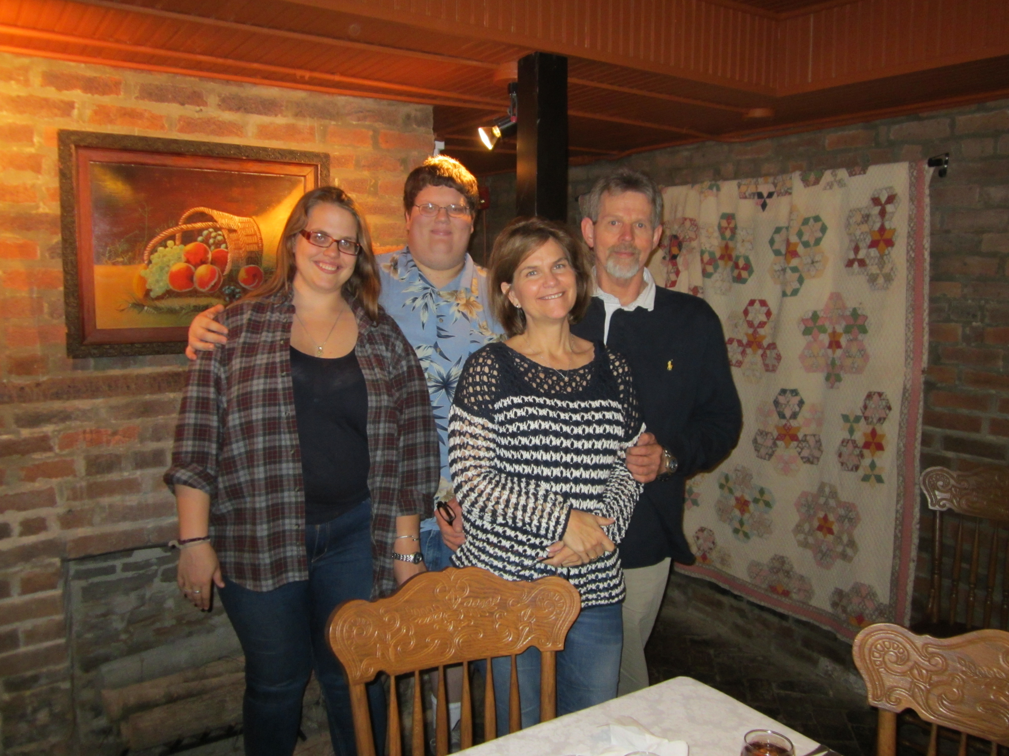
My family
I am thankful for my family because they always support me and have never let me down.

Slide 4

My country
I am thankful for my country because I have the freedom to teach and teach children that they can do anything if they work hard and do their best.

Slide 5

My House
I am thankful for my house because I can come and relax and get ready to teach my class the next day.

Slide 6

My health
I am thankful for my healthy body and my healthy mind so that I can teach.

